Slide 1
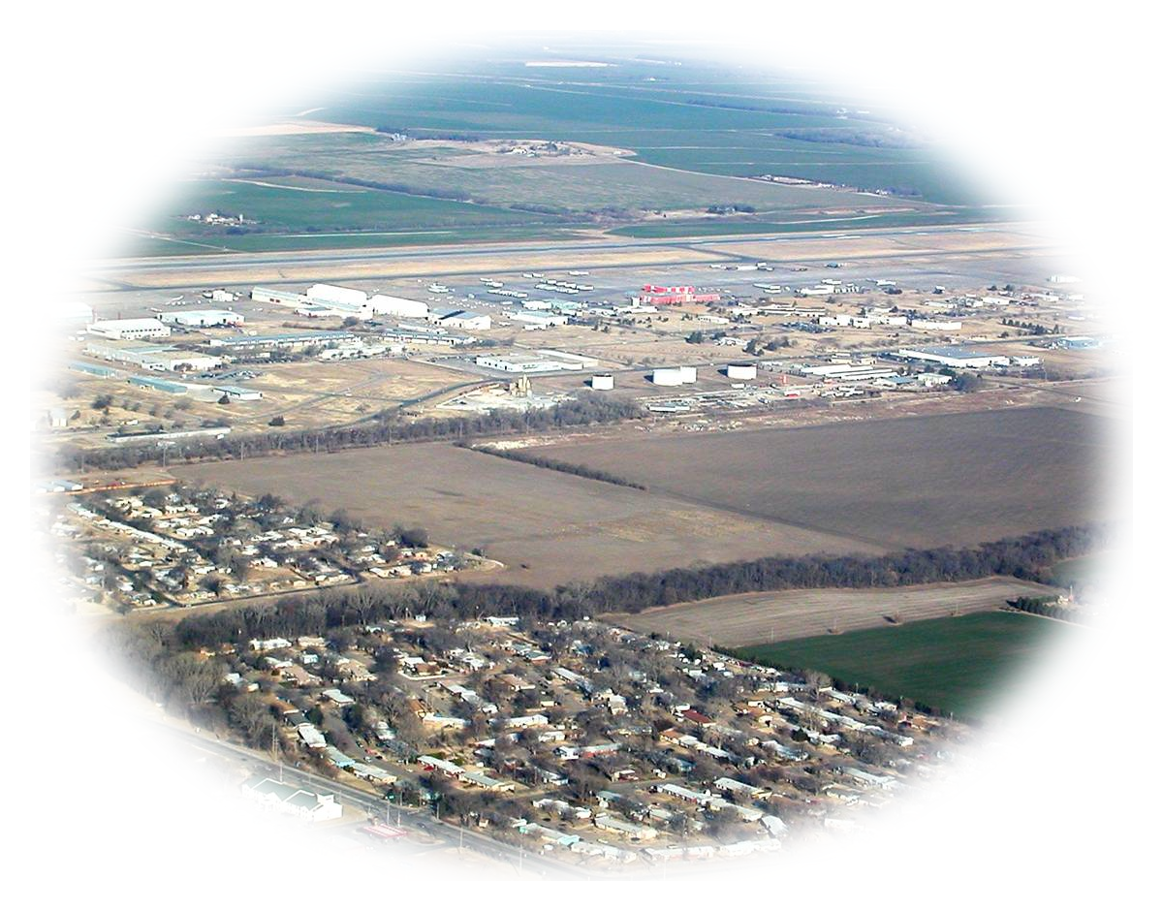
Remediation Project Update Former Schilling AFB, Salina, KS November 16, 2022

Slide 2
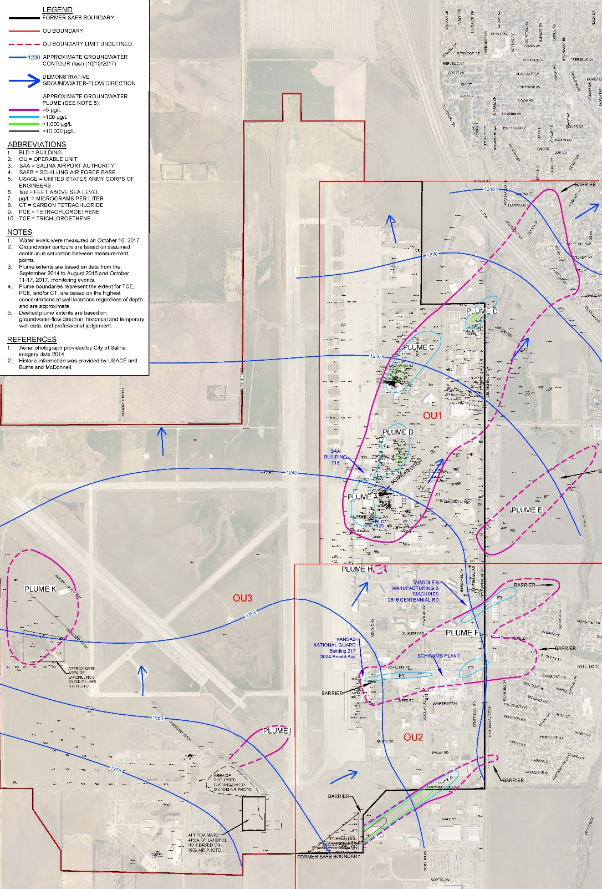
Groundwater Plumes
Plumes A, B, C and D
Plume E
Plume F
Plume G
Notes:
Groundwater plumes shown by purple outlines
11 plumes from multiple sources
Plumes A-D commingled but from different sources
Highest concentrations in Plume A, C, and G

Slide 3
Remedial Design Objectives:
The overall Remedial Design objective is addressing the highest risk areas in the early remediation implementation to mitigate potential exposure.
Vapor intrusion risk will be addressed by remediation of the soil sources within the first two years.
Risk associated with the highest groundwater concentration areas will be addressed by the DGR system.
Plume migration will be addressed by installation of the downgradient PRBs within the first two years.

Slide 4
CAD Remediation Plan
Soil source area remediation
Plumes A and C – In situ thermal desorption
Plume B – Soil excavation and off-site disposal
Source control
Plumes F and G – Emplaced permeable reactive barrier (PRB)

Slide 5
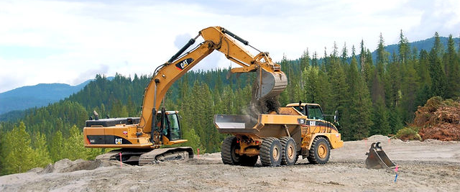
Excavation and Off-Site Disposal
(dig and haul)
Image: Clear Creek Construction
Notes:
Soil will be excavated, stockpiled, and characterized. If the TCE concentrations are high, soil will be transported to a licensed landfill for disposal. If the concentrations are below the KDHE standards, the soil will be returned to the excavation as backfill.

Slide 6
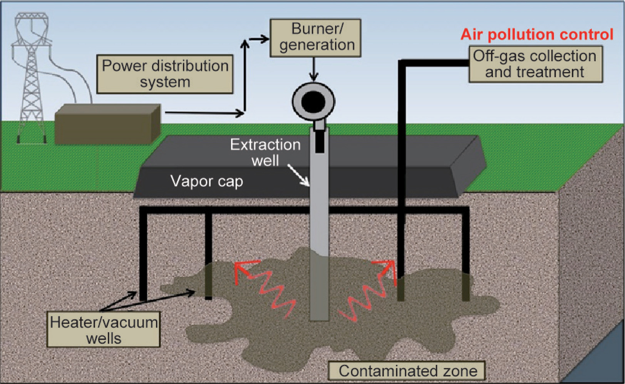
In Situ Thermal Desorption
(thermal treatment)
Image: ScienceDirect.com
Notes:
In Situ Thermal Desorption (ISTD) is a soil remediation process in which heat and vacuum are applied simultaneously to subsurface soils. As the temperature rises, the volatile contaminants (like TCE) become vapors that can be collected and treated. This technology works well in clayey soil, at depth, and in bedrock.

Slide 7
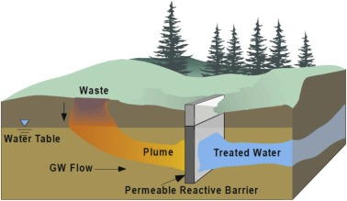
Permeable Reactive Barrier
(PRB)
Image: ScienceDirect.com
Notes:
A permeable reactive barrier, or “PRB,” is a wall created below ground to clean up contaminated groundwater. The wall is “permeable,” which means that groundwater can flow through it. The “reactive” materials that make up the wall either trap harmful contaminants or make them less harmful. The treated groundwater flows out the other side of the wall.

Slide 8
CAD Remediation Plan
Groundwater remediation
Plumes A-D, E, F, and G – Directed groundwater recirculation (DGR)
(to remediate impacted groundwater)
Plumes D, E, F and G – Injected permeable reactive barrier (PRB)
(to prevent further plume migration)

Slide 9
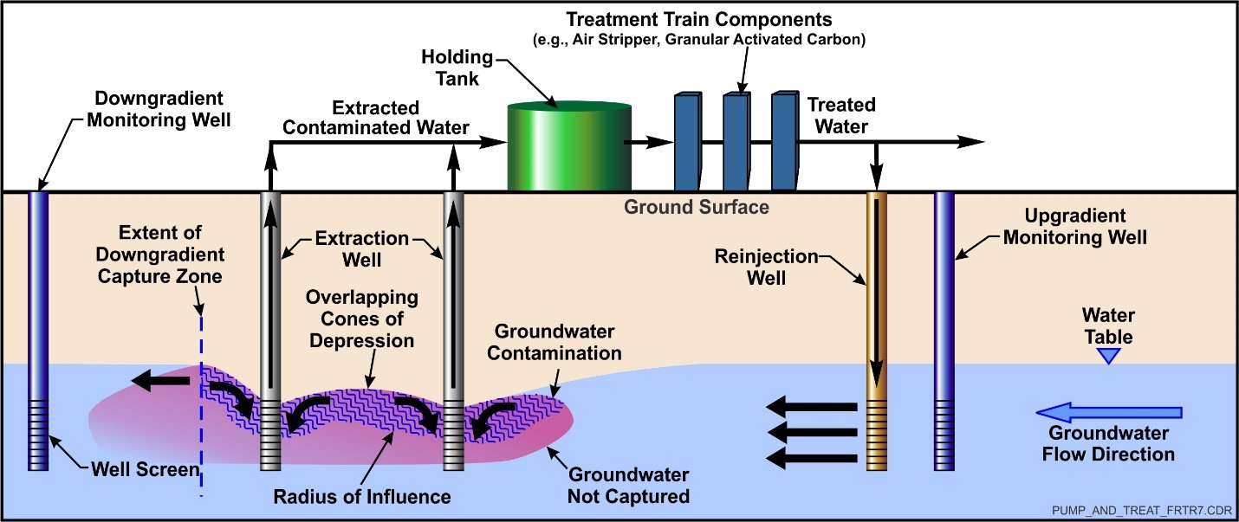
Directed Groundwater Recirculation
(DGR)
Image: USEPA
Notes:
To remediate the groundwater plumes, we are planning a directed groundwater recirculation system. Groundwater will be pumped from the ground and piped to a central treatment building where different technologies will remove the contaminants and add amendments to the treated water. The water will then be reinjected around the edges of the plumes, flushing clean water through the contaminated zones. The amendments we are adding will help to speed the biological processes that will break down the contaminants in the subsurface.

Slide 10
Current Activities:
Investigation in support of the Remedial Design:
High resolution site characterization (HRSC) in Plume A and C sources (planned thermal treatment)
HRSC at Plumes F and G sources (planned emplaced PRBs)
HRSC at downgradient ends of Plumes D, E, F, and G (planned PRBs)
Testing of extraction/injection test wells (planned DGR system)
Notes:
Discuss possible alternate remediation technologies for Plumes F and G source areas

Slide 11
Current Activities:
Monitoring of groundwater and indoor air
Design of remediation components:
Removal of impacted soil in Plume B
Thermal treatment at Plumes A and C sources
DGR groundwater collection system and treatment building

Slide 12
Anticipated Upcoming Schedule:
Completion of remedial design, approval from KDHE, solicitation/selection of contractor(s), and implementation of source area remediation actions. Target implementation start dates:
Removal of impacted soil in Plume B – Q2 2023
Injected PRBs – Q3 2023
Thermal treatment – Q4 2023
Emplaced PRBs (or other) – schedule dependent on results of current investigation

Slide 13
Anticipated Upcoming Schedule:
Completion of remedial design, approval from KDHE, solicitation/selection of contractor(s), and implementation of source area remediation actions.
DGR system
System design - August 2024
System construction - January 2025
System completion/startup - December 2026
Notes:
Update computer model of system with investigation data
Optimize number and location of extraction and injection wells

Slide 14
Questions?

